Slide 1

HA - Design Text editor using Swing
Object Oriented Programming
Guide :Prof. Dnyaneshwar Kanade
Student Names :
1. D26 Aayush Surawar 11910859
2. D27 Samarth Takbhate 11910739
3. D30 Gopal Tapadiya 11911318
4. D31 Shivam Tapre 11910774
5. D43 Umesh Wanare 11911112

Slide 2
Content
HA Problem Statement
Domain : Design
Tools
Design Outputs
Conclusion
Future Scope
References

Slide 3

HA Problem Statement
To create a simple text editor in Java Swing using a JTextArea, a JMenuBar and add JMenu to it and JMenuItems. All the menu items will have actionListener to detect any action.

Slide 4


Tools
Intellij Idea compiler
Java swing

Slide 5
Tools
Java swing :
Java Swing is a part of Java Foundation Classes (JFC) that is used to create window-based applications.
It is built on the top of AWT (Abstract Windowing Toolkit) API and entirely written in java.
Unlike AWT, Java Swing provides platform-independent and lightweight components.
The javax.swing package provides classes for java swing API such as JButton, JTextField, JTextArea, JRadioButton, JCheckbox, JMenu, JColorChooser etc.

Slide 6
Tools
Java textarea:
JTextArea is a part of java Swing package .
It represents a multi line area that displays text. It is used to edit the text .
JTextArea inherits JComponent class. The text in JTextArea can be set to different available fonts and can be appended to new text .
A text area can be customized to the need of user .

Slide 7
Tools
Java menubar:
JMenuBar is an implementation of menu bar .
The JMenuBar contains one or more JMenu objects, when the JMenu objects are selected they display a popup showing one or more JMenuItems .
JMenu basically represents a menu . It contains several JMenuItem Object.
It may also contain JMenu Objects (or submenu).

Slide 8
Tools
Java panel :
JPanel, a part of Java Swing package, is a container that can store a group of components.
The main task of JPanel is to organize components, various layouts can be set in JPanel which provide better organisation of components, however it does not have a title bar.

Slide 9
Tools
Java swing ActionListener() :
The class which processes the ActionEvent should implement this interface.
The object of that class must be registered with a component. The object can be registered using the addActionListener() method.
When the action event occurs, that object's actionPerformed method is invoked.

Slide 10
Tools
Java JTextPane :
JTextPane is a subclass of JEditorPane class.
JTextPane is used for styled document with embedded images and components.
It is text component that can be marked up with attributes that are represented graphically.
JTextPane uses a DefaultStyledDocument as its default model.

Slide 11
Output
Following are the features added to the text editor with their functions:
The menu added to the menubars-
1) File : It includes 5 menuitems –
New : This menuitem is used to create a new blank file.
Open : This menuitem is used to open a file.
Save : This menuitem is used to save a file.
Print : This menuitem is used to print the components of the text area.
Exit : This menuitem closes the frame.
2) Edit : It includes 3 menuitems –
Cut : This menuitem is to cut the selected area and copy it to clipboard.
Copy : This menuitem is to copy the selected area to the clipboard.
Paste : This menuitem is to paste the text from the clipboard to the text area.

Slide 12
Output
The buttons added to panel –
Bold : To bold the text
Italic : To Italic the text
Underline : To underline the text
Set Color: To change the color of text.
Undo: To undo the action.
Redo: To redo the action.

Slide 13
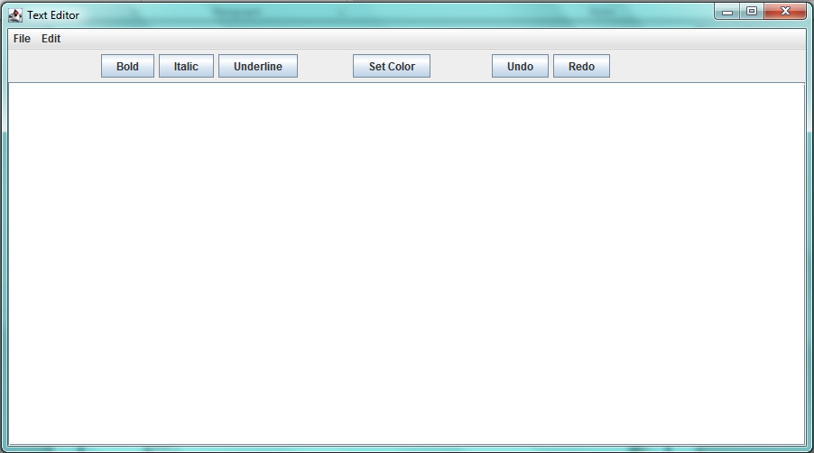
Design Output
Text Editor Frame

Slide 14
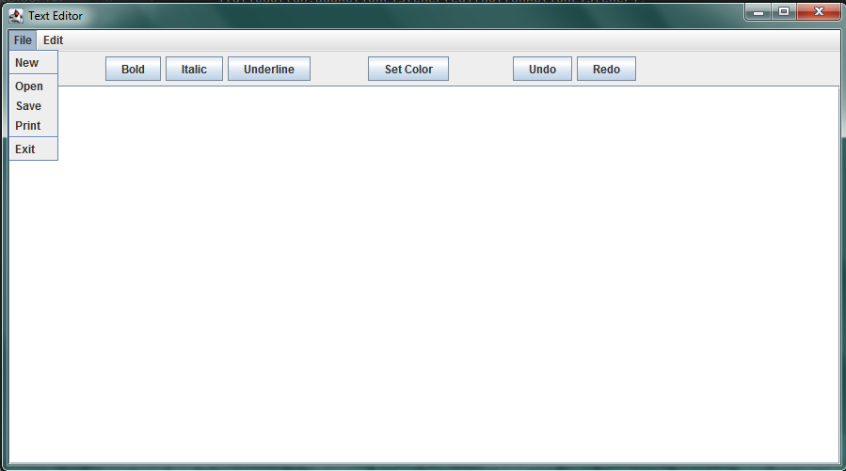
Design Output
File Menu

Slide 15
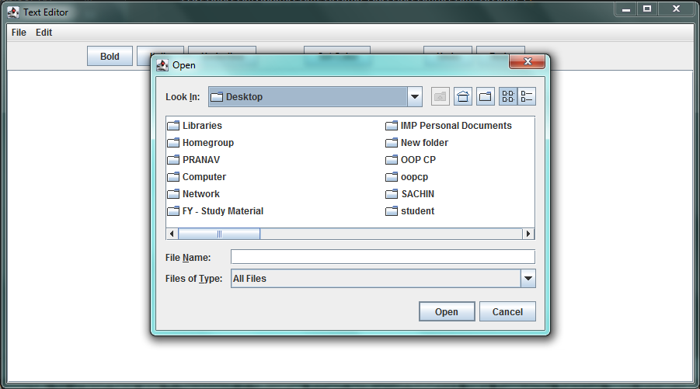
Design Output
Open

Slide 16
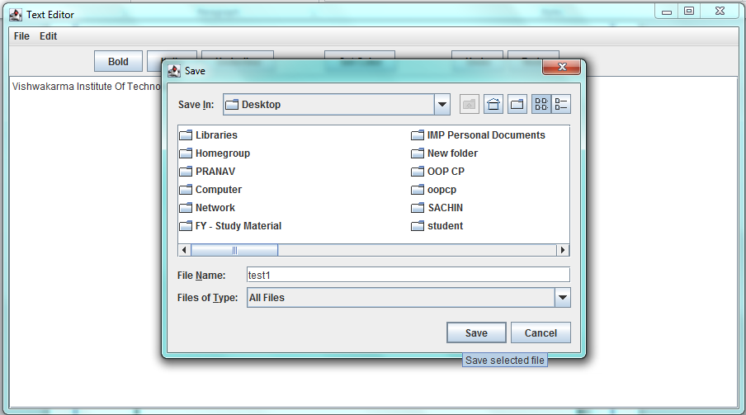
Design Output
Save

Slide 17
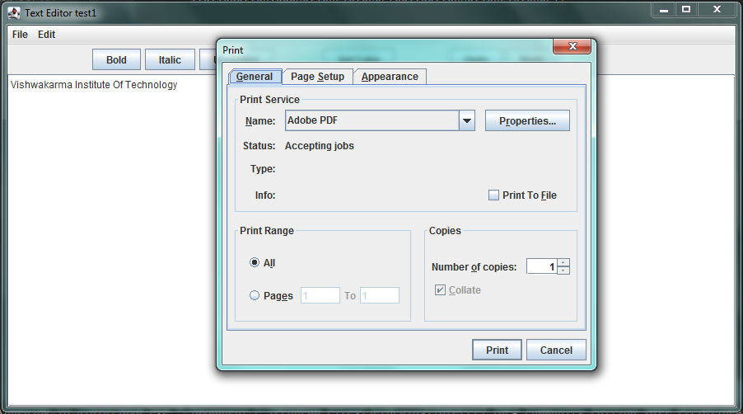
Design Output
Print

Slide 18
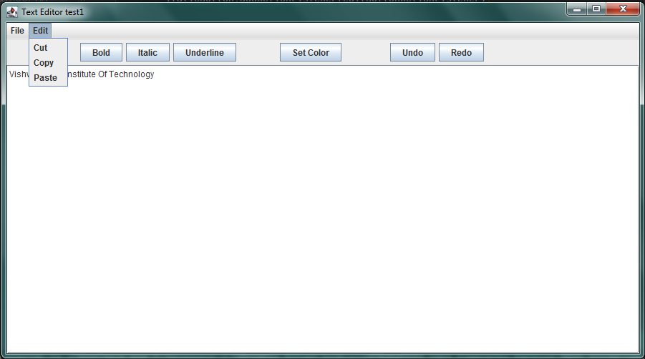
Design Output
Edit Menu

Slide 19
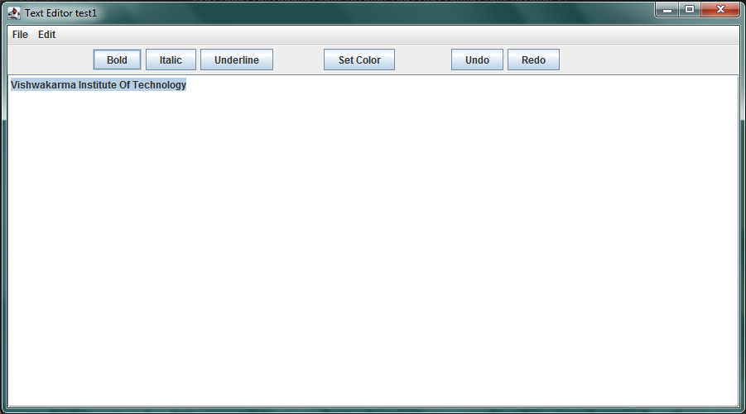
Design Output
Bold

Slide 20
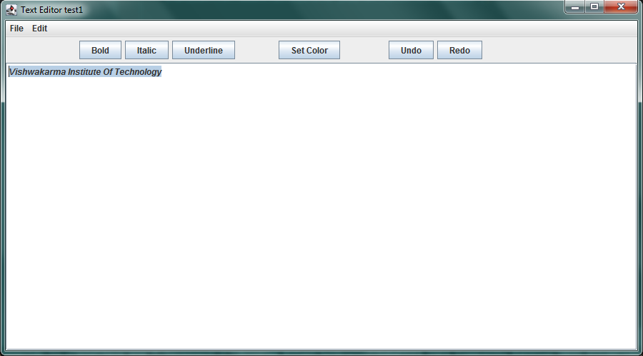
Design Output
Italic

Slide 21
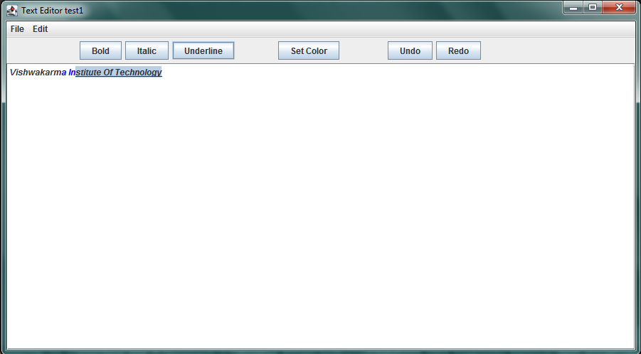
Design Output
Underline

Slide 22
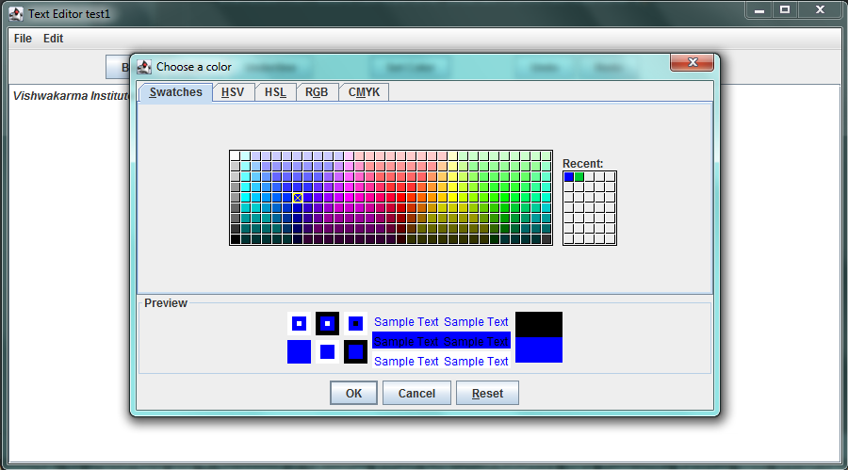
Design Output
Set color

Slide 23
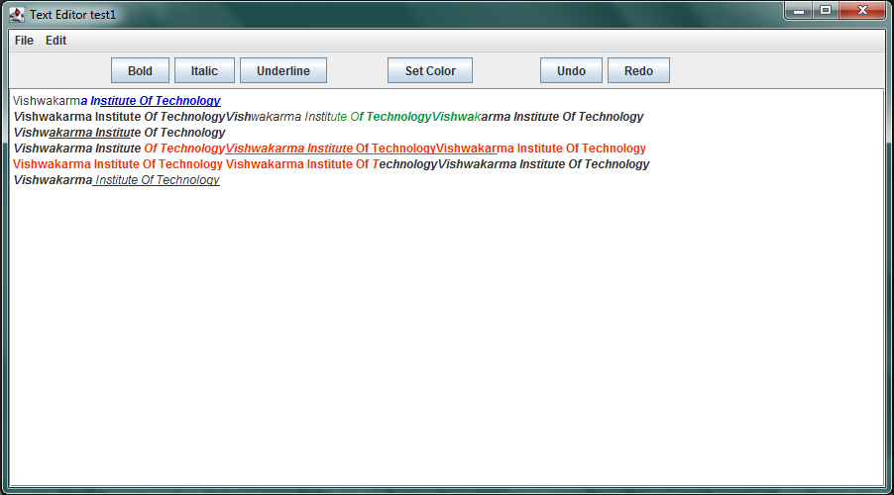
Design Output
Final frame : Screenshot of frame where all features are applied

Slide 24
Conclusion
We have designed a text editor using java swing .
It contains the features like open the file , save the file , print the file and open a new file .
The cut , copy and paste option are also there to edit text. Additionally the Bold, Italic , Underline , Set color , undo and redo buttons are added to the panel to decorate the text with easy access.

Slide 25
Future Scope
As we can see in these design , bold , Italic , underline & set color buttons are added ; so in future we can add the button to change the font of the text also we can add a feature to change the font size of text .
There is chance to add feature like alignment of text ( i.e. Left , Middle , Right ) .
Also in future , we can add the feature of insert of image in the text editor . So it will be more like MS Word.

Slide 26
References
https://www.javatpoint.com/java-swing
https://www.javatpoint.com/java-jtextfield
https://www.javatpoint.com/java-jmenuitem-and-jmenu
https://en.wikipedia.org/wiki/Swing_(Java)
https://youtu.be/M03qEx6BYkM

Slide 27
Thank You

